Slide 1
(18-A) Advanced OOP Practice

Slide 2
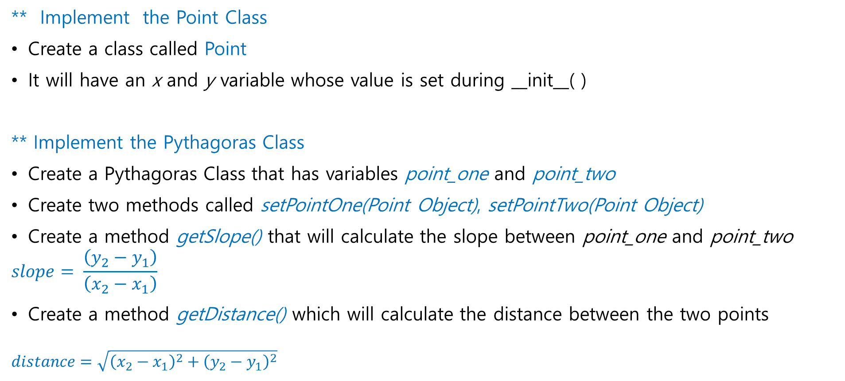
Advanced OOP (1번): Point Class & Pythagoras Class
** Implement the Point Class
Create a class called Point
It will have an x and y variable whose value is set during __init__( )
** Implement the Pythagoras Class
Create a Pythagoras Class that has variables point_one and point_two
Create two methods called setPointOne(Point Object), setPointTwo(Point Object)
Create a method getSlope() that will calculate the slope between point_one and point_two
$$slope= \frac{\left(y_{2}−y_{1}\right)}{\left(x_{2}−x_{1}\right)}$$
Create a method getDistance() which will calculate the distance between the two points
$$distance=\sqrt{{\left(x_{2}−x_{1}\right)}^{2}+{\left(y_{2}−y_{1}\right)}^{2}}$$

Slide 3
Advanced OOP (2번) : Calculator Class [1/2]
Implement Calculator Class
This class will have the following methods:
add(int): add number
subtract(int): subtract number
multiply(int): multiply number
equals(boolean=False): (True = save and print result, False = save result)
show_history(): show all calculations solved till now. If there is none, print “No calculation done yet!”
* 실제 계산기와은 다르게, 곱셈 나눗셈이 섞인 연산 시 먼저 계산하는게 아니라 앞에서부터 순서대로 계산합니다. 뒤의 result에서 보시면 알겠지만, ((10-5)*2) 처럼 괄호가 생략되어 있다고 간주하고 작성하세요.

Slide 4
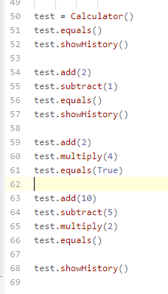
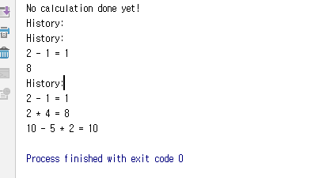
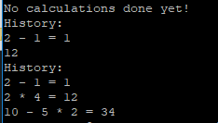
Advanced OOP (2번) : Calculator Class [2/2]
Main Function
Result

Slide 5
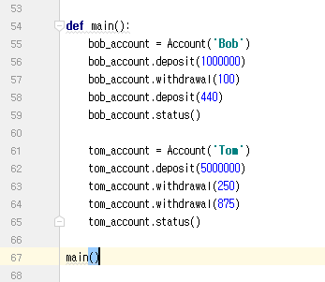
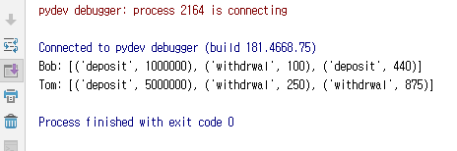
Advanced OOP (3번): Account Class [1/2]
An Account class code is given in the next page
Change the code by adding a variable called transactions which will keep a record of all the deposit and withdrawal as seen below
Result Output

Slide 6
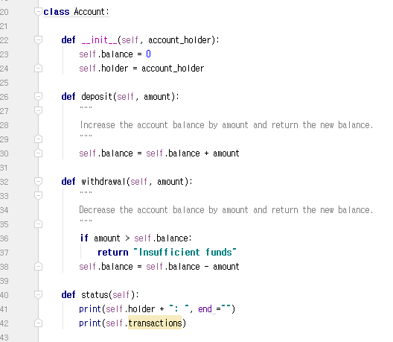
Advanced OOP (3번): Account Class [2/2]
Given Account Class Frame

Slide 7
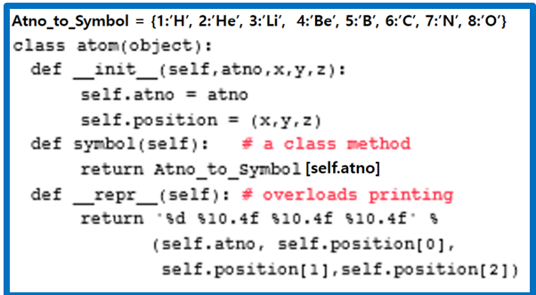
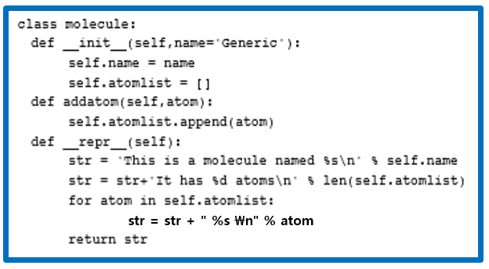

Advanced OOP (4번): Atom and Molecule [1/2]
아래 class 들의 variable과 method의 작동원리를 중심으로 설명하시오
str = str + " %s \n" % atom

Slide 8
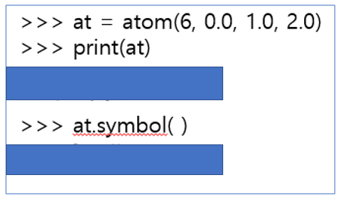
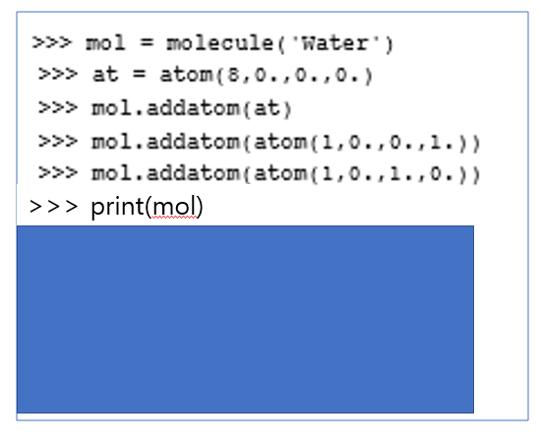
Advanced OOP (4번): Atom and Molecule [2/2]
앞 페이지의 class들을 이용하여 아래 code 결과를 보이시오

Slide 9
Advanced OOP (5번): Professor and Student [1/3]
The table below is a list of professors and student.
Reviewing the column types, create 3 classes that best fit the table data below and the methods in the next slide.
Type | Name | Course | Depart. | Salary | Year | Credit
Student | Steven Jobs |  | CSE |  | 3rd | 12
Professor | Bill Gates | Oper. Syst. | CSE | 6,000
Student | Elon Musk |  | CSE |  | 3rd | 10
Student | Mark Zuck |  | CSE |  | 2nd | 14
Professor | Tim Cook | Soft. Arch. | CSE | 5,500
Professor | Back Space | Algorithm | CSE | 5,800

Slide 10
Advanced OOP (5번): Professor and Student [2/3]
Values for each class should be set during initialization.
Place following methods in the most appropriate class:
getName( )
getDepart( )
getCredit( )
setCredit( )
increaseYear( ): increase year by 1
getCourse( )
getAnnualSalary( ): salary * 12
raiseSalary(int percent): increase salary by percent, return new salary

Slide 11
Advanced OOP (5번): Professor and Student [3/3]
Using the class created in the previous page:
Create an object called tim_cook
Set tim_cook values to match the data from the table
Write a code that will calculate the total amount of salary tim_cook will receive in five years
Write a code that will calculate the total amount of salary of tim_cook if his salary is raised 15% every year for five year

Slide 12

Advanced OOP (5번): 앞 3페이지에 있는 내용을 바탕으로 아래 Code Skeleton을 채우시요
Result

Slide 13
Advanced OOP (6번): Staff and Student [1/3]
The table below is a list of staff and student.
Reviewing the column types, create 3 classes that best fit the table data below and the methods in the next slide.
Type | Name | Address | GPA | Year | School | Fee | Annual Pay
Staff | Tom | Gangnam |  |  | Yonsei |  | $35,0000
Student | Ollie | Seocho | 4.1 | 1 |  | $15,000
Staff | Candy | Bangbae |  |  | SNU |  | $45,000
Staff | Dane | Shindorim |  |  | Sogang |  | $20,000
Student | Rick | Hongik | 3.8 | 2 |  | $25,000
Student | Matt | Sinchon | 3.3 | 4 |  | $45,000
Student | James | Busan | 3.6 | 3 |  | $35,000

Slide 14
Advanced OOP (6번): Staff and Student [2/3]
Values for each class should be set during initialization.
Place following methods in the most appropriate class:
getName()
getAddress()
getGpa()
setGpa()
hasMinimumGpa(): above 3.5 return True, below 3.5 return False
willGraduateNextYear(): return True for 4 year students only
getSchool()
getMonthlyPay():
raiseAnnualPay(int percent): increase salary by percent

Slide 15
Advanced OOP (6번): Staff and Student [3/3]
Using the class created in the previous page:
Create an object called tom and dane
Set tom and dane values to match the data from the table
The seven year:
Tom will receive 7% raise in annual salary
Dane will receive 15% raise in annual salary
Write a code that will calculate tom and dane annual salary after seven year
Write a code to see who has a larger monthly pay
If tom is larger print “Tom has a larger monthly pay”
If dane is larger print “Dane has a larger monthly pay”

Slide 16
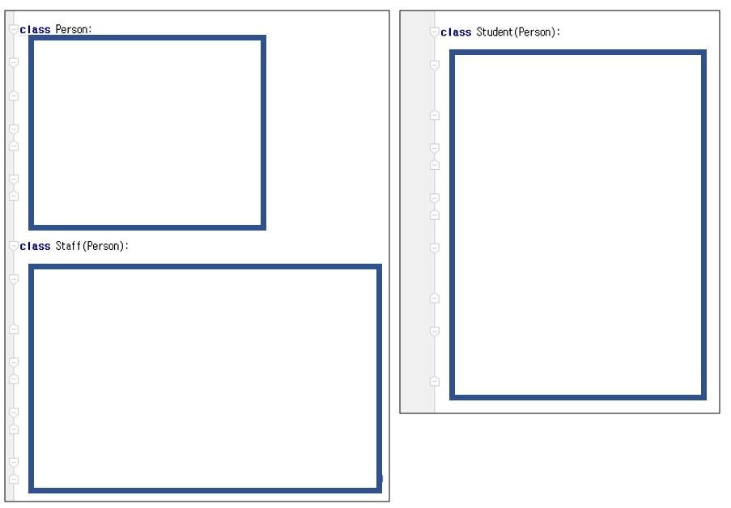

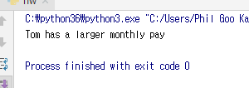
Advanced OOP (6번): 앞 3페이지에 있는 내용을 바탕으로 아래 Code Skeleton을 채우시요
Result

